Slide 1
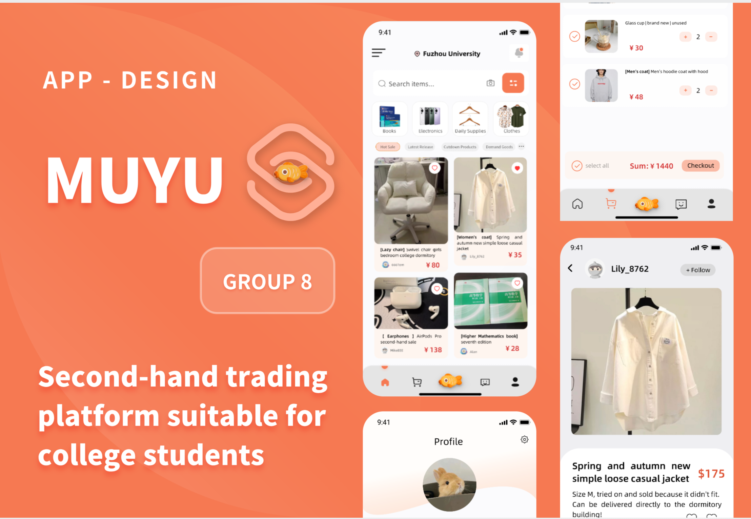
PRESENTATION
MuYu Campus Second Hand Trading WeChat Mini Program
——UI Design Project Debrief

Slide 2

UI Design
Concept
Project Overview
CONTENT
Research Experience
Improvement
Plan

Slide 3
01
Project Overview

Slide 4
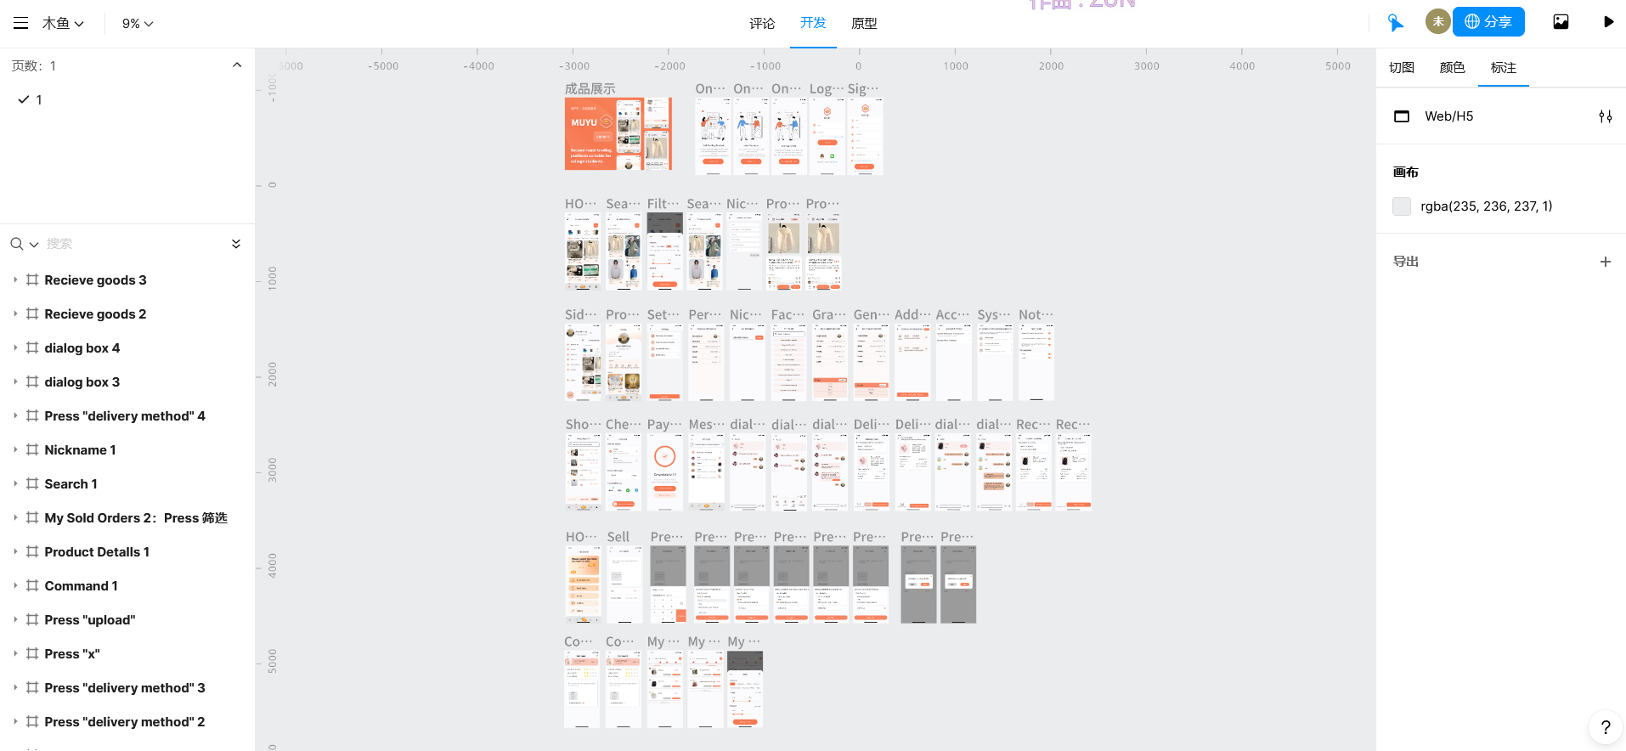
01
Project Overview
UI development Tools:
Instant Design(A prototyping platform for real-time collaboration)

Slide 5
01
Project Overview
Project Name：MuYu Campus Second Hand Trading WeChat Mini Program
Logo
icon

Slide 6
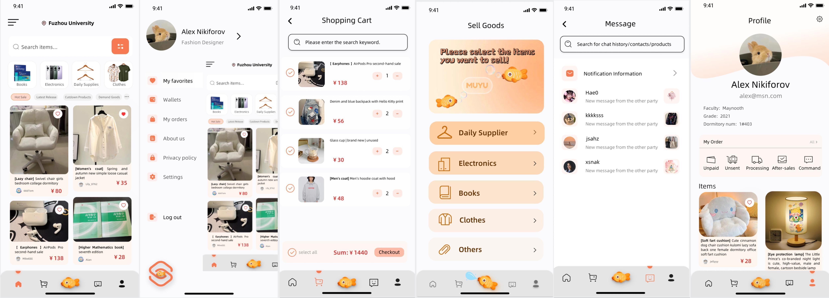
01
Project Overview
Main Interface

Slide 7
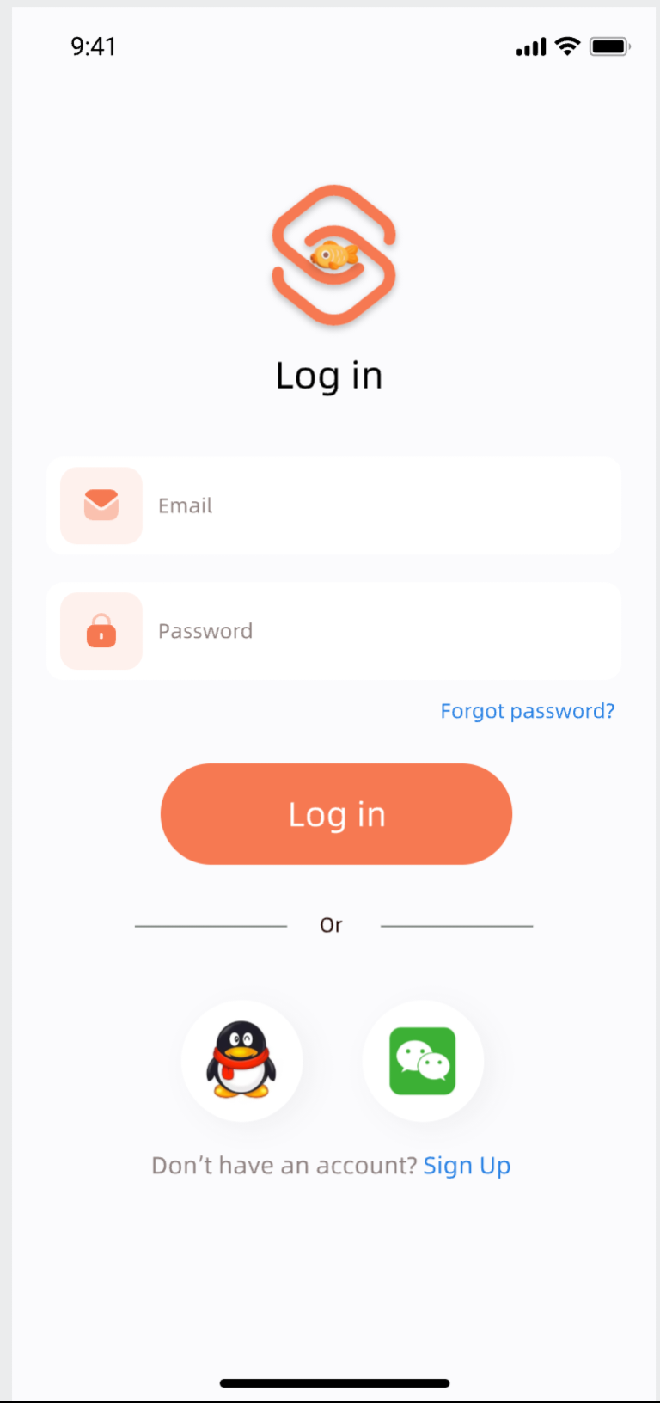
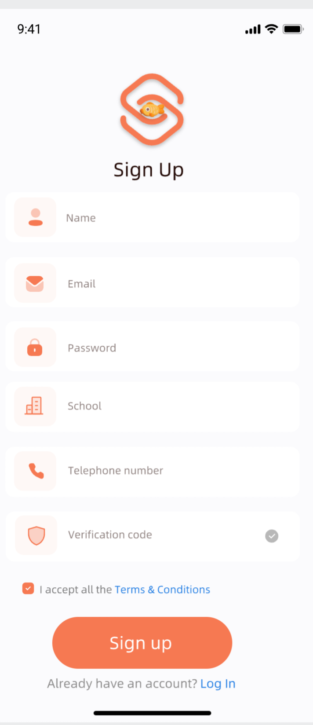
01
Project Overview
Guidance 1:
Login registration

Slide 8
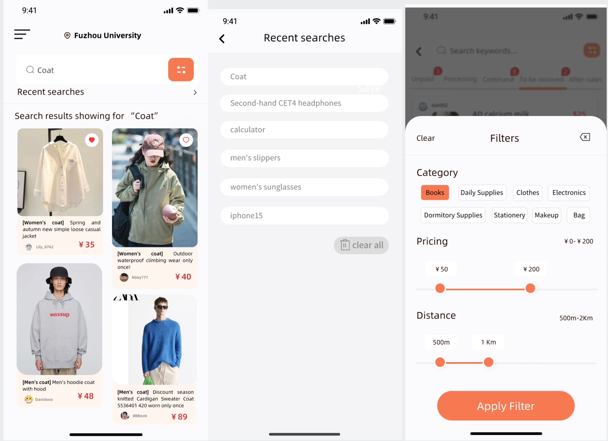
01
Project Overview
Guidance 2 Search

Slide 9
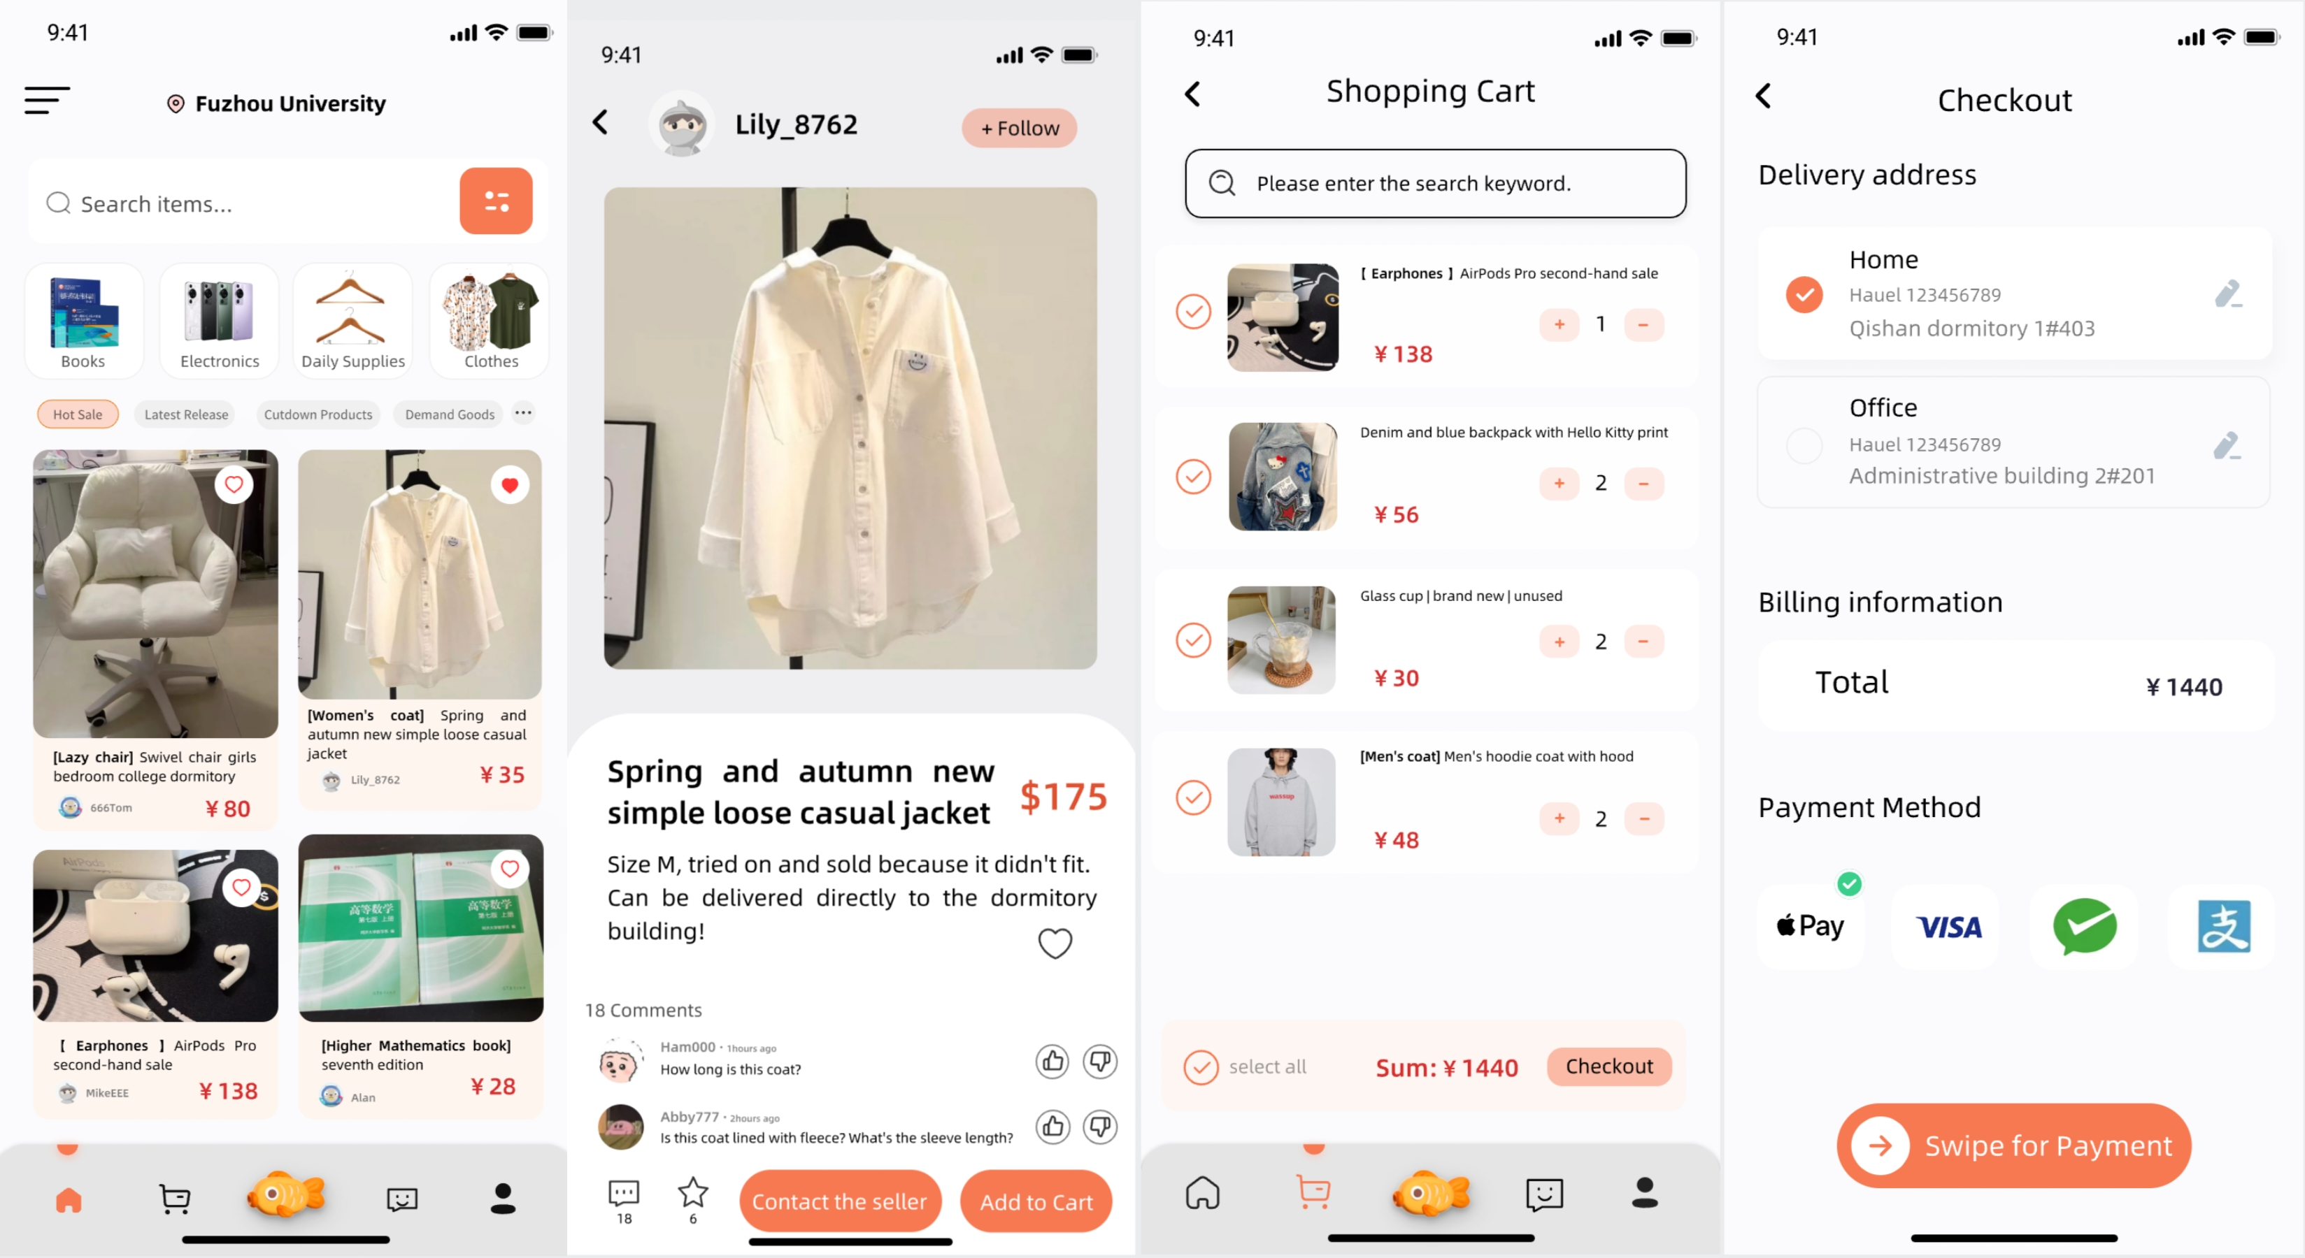
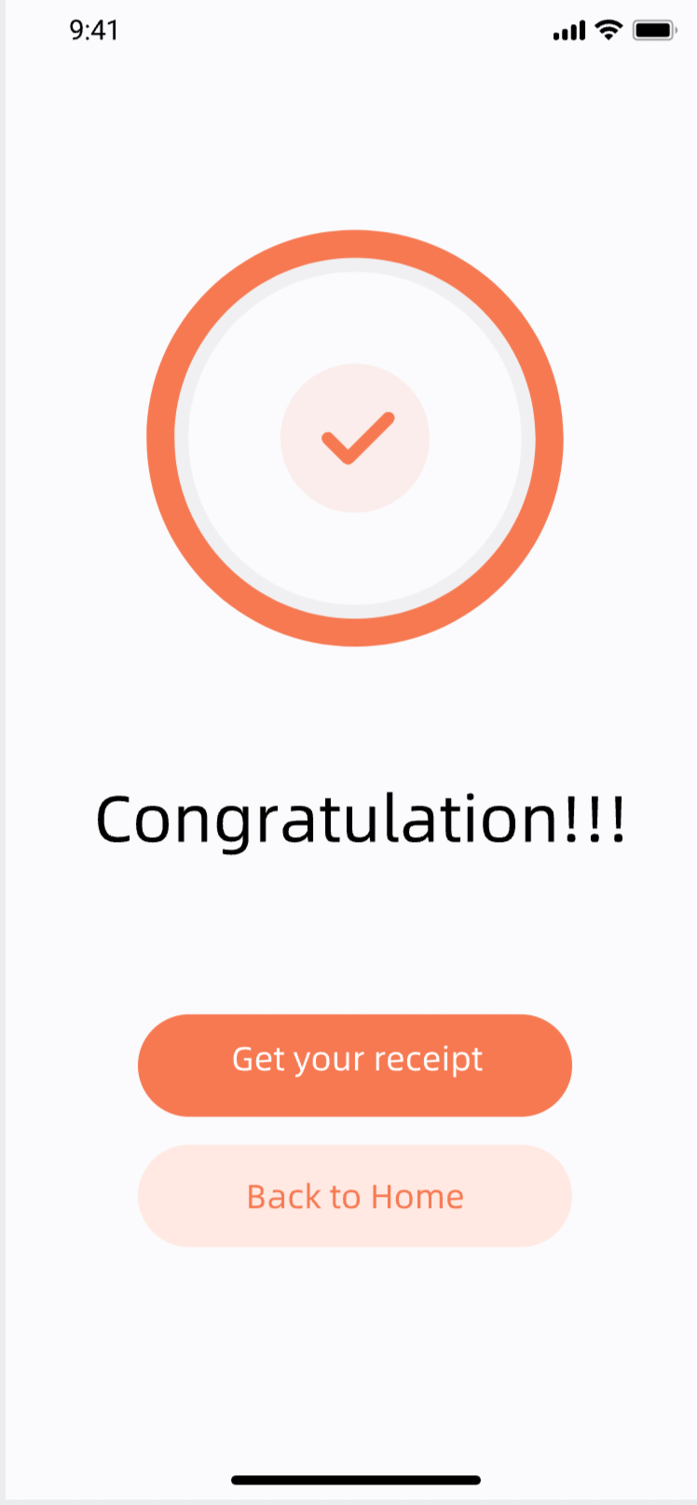
01
Project Overview
Guidance 3: Purchase

Slide 10
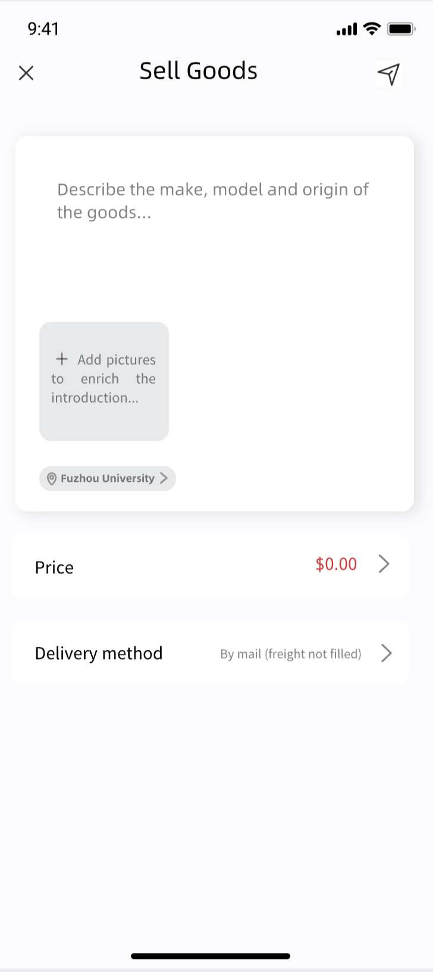
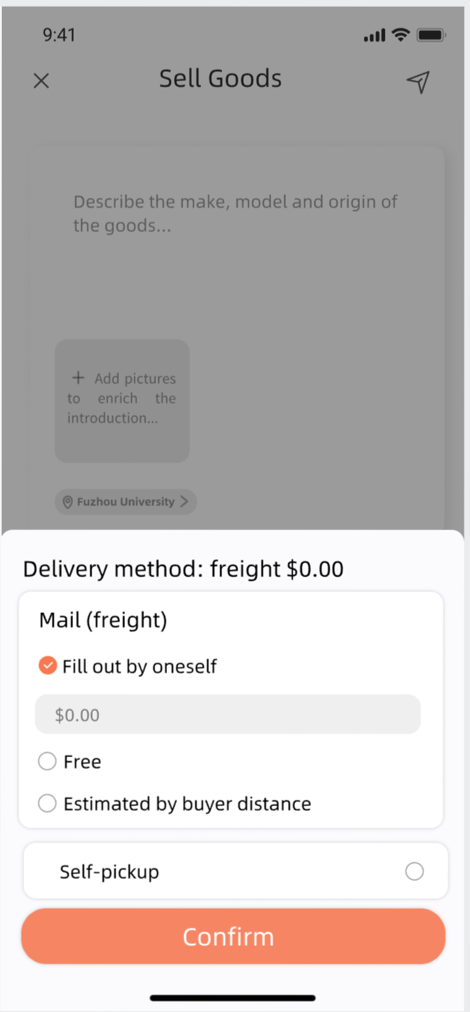
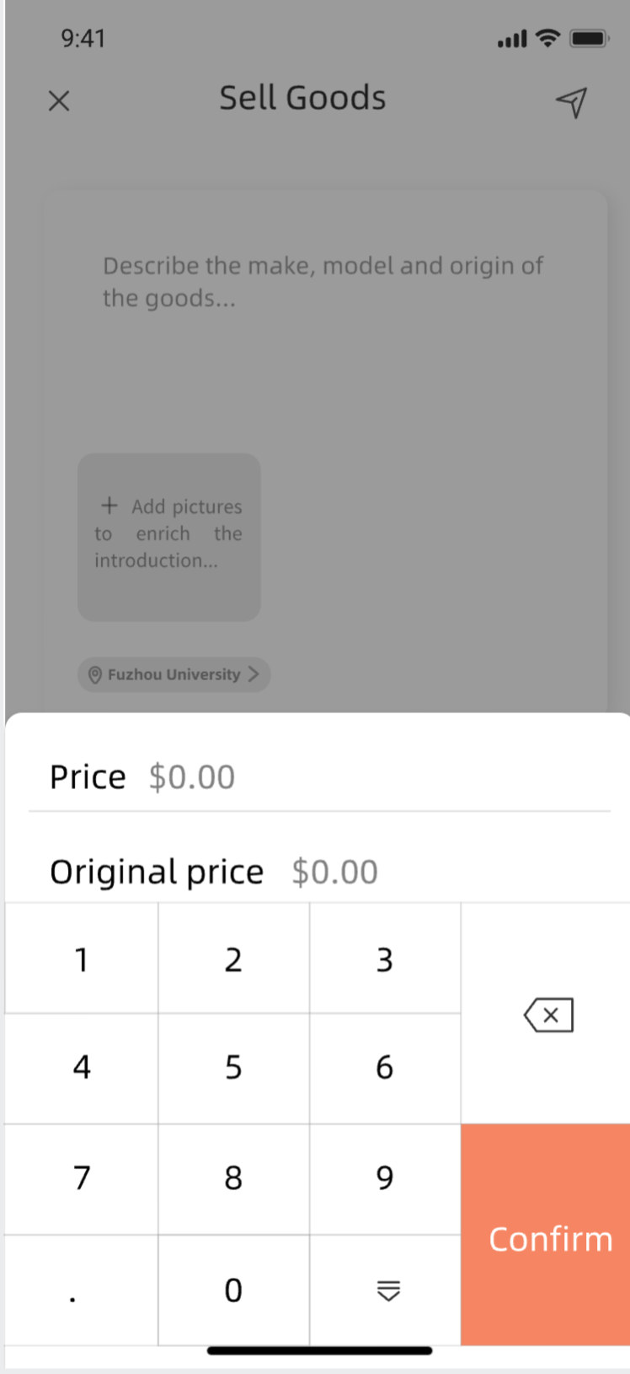
01
Project Overview
Guidance 4: Merchandise upload

Slide 11
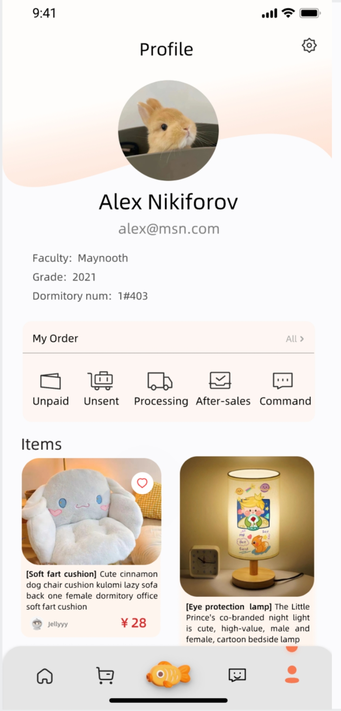
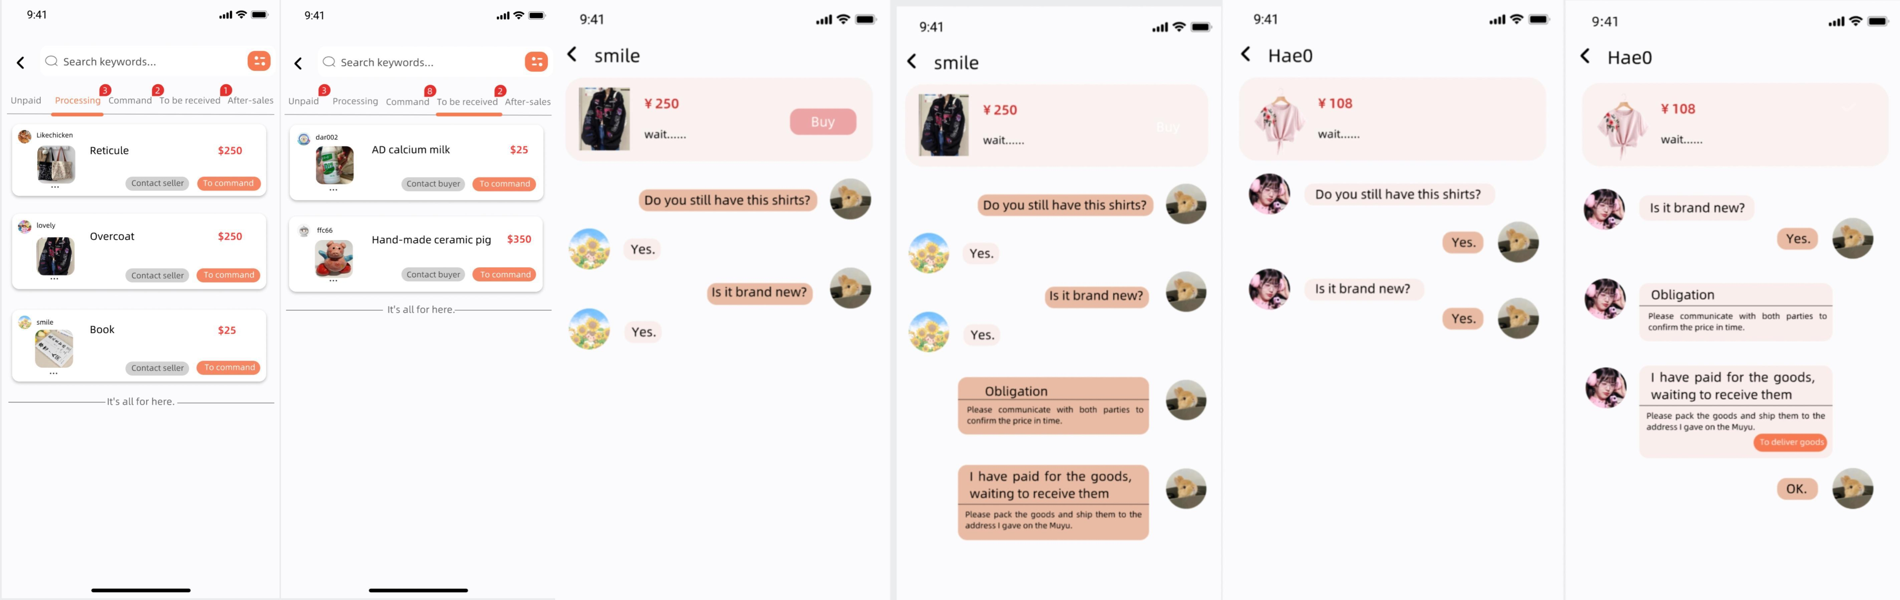
01
Project Overview
Guidance 5:
Information confirmation

Slide 12
01
Project Overview
Guidance 6:
Contacting the Seller/Buyer

Slide 13
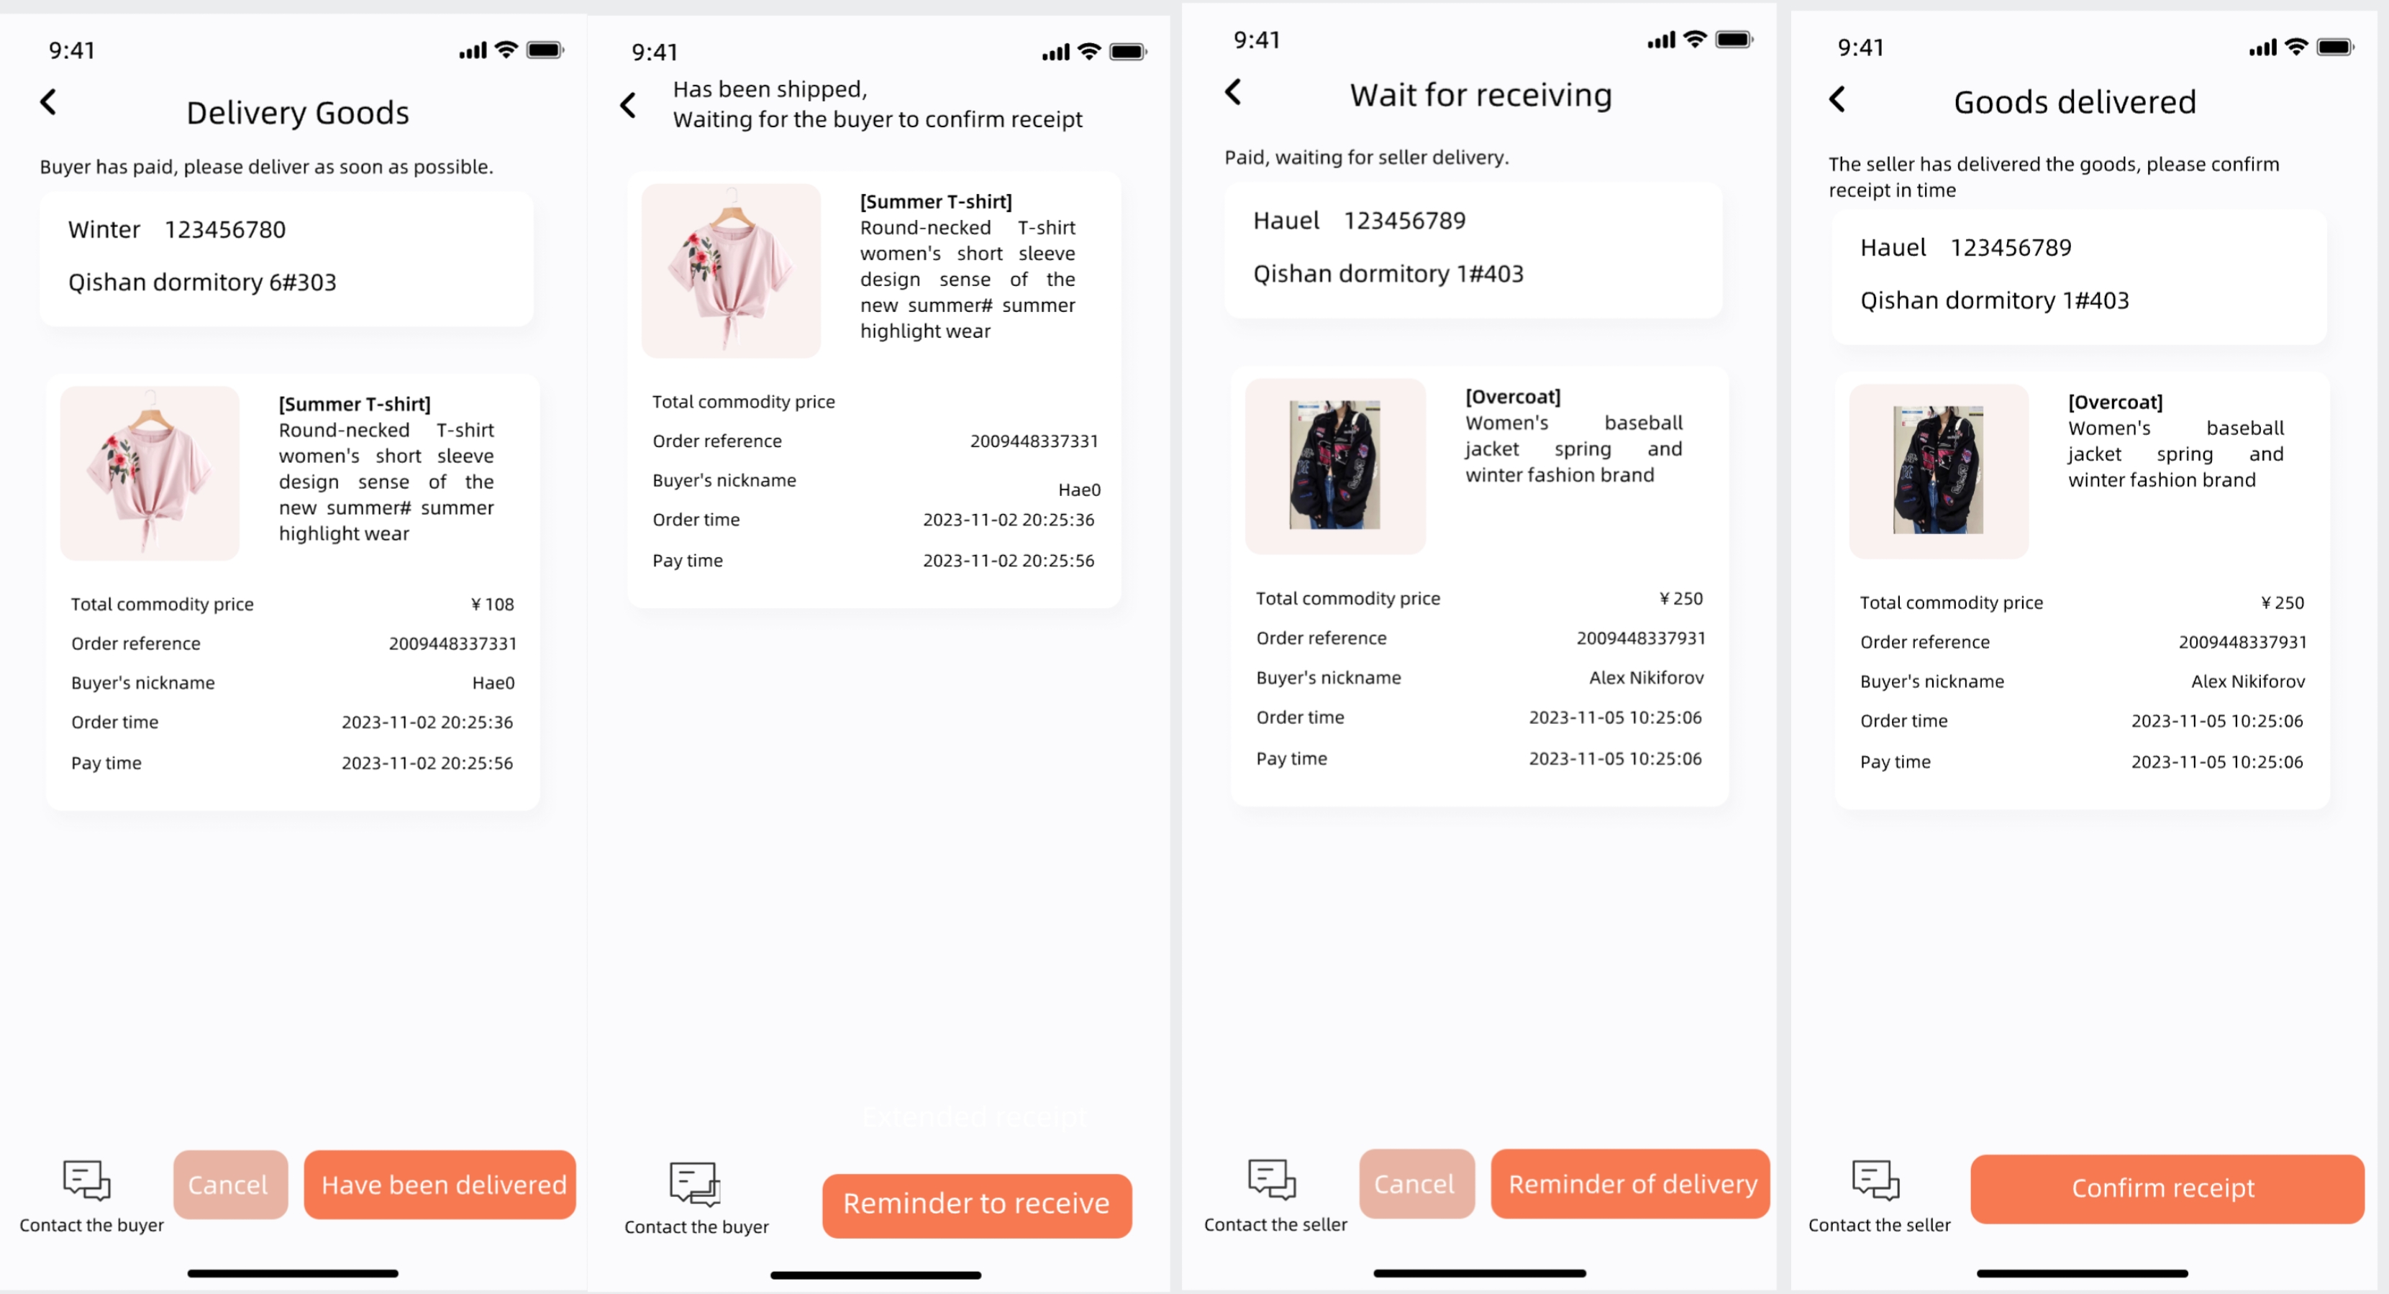
01
Project Overview
Module 7:
Order Status (Seller/Buyer)

Slide 14
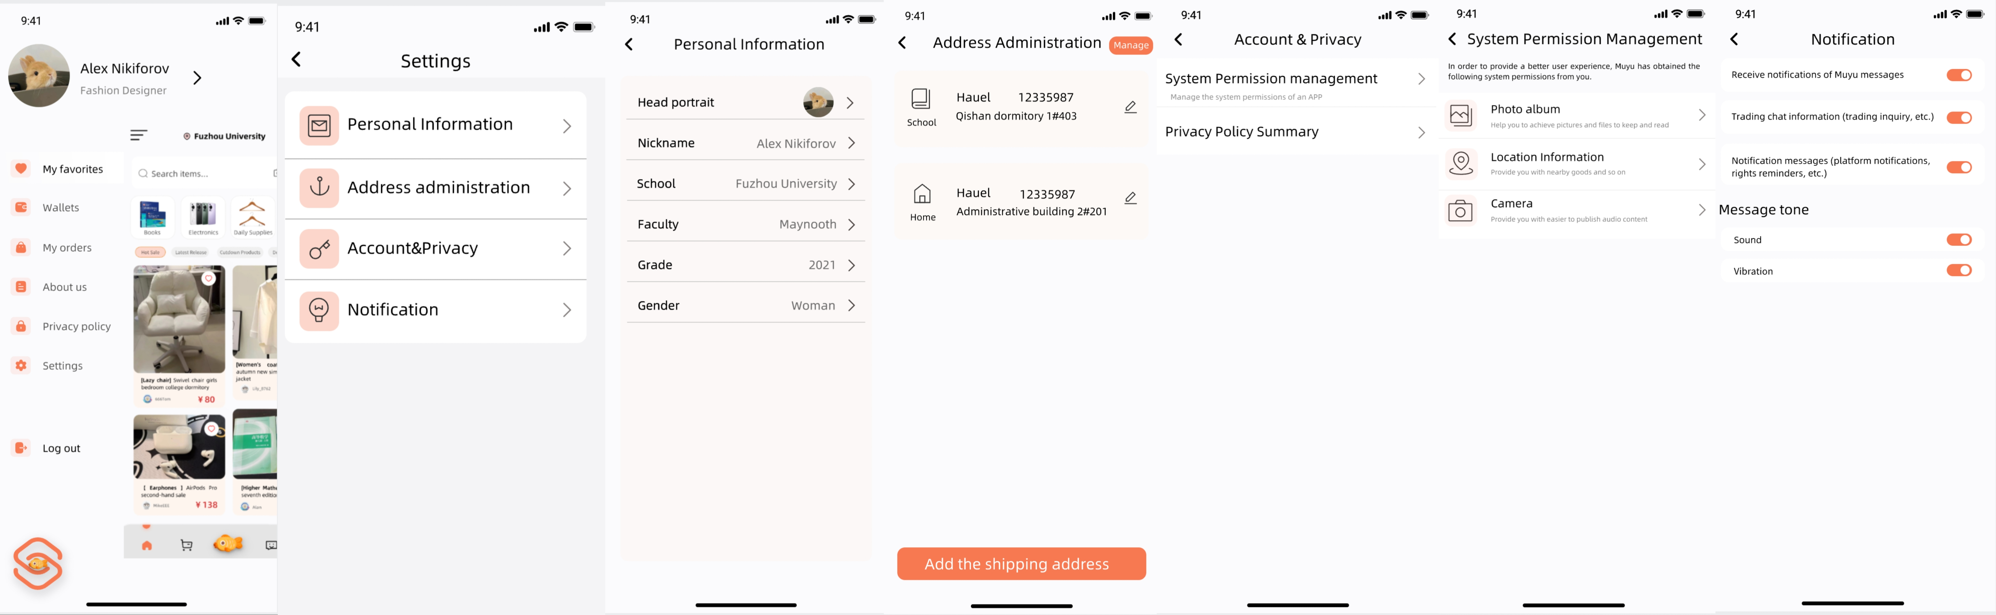
01
Project Overview
Guidance 8
Setup

Slide 15
02
UI Design Concept

Slide 16
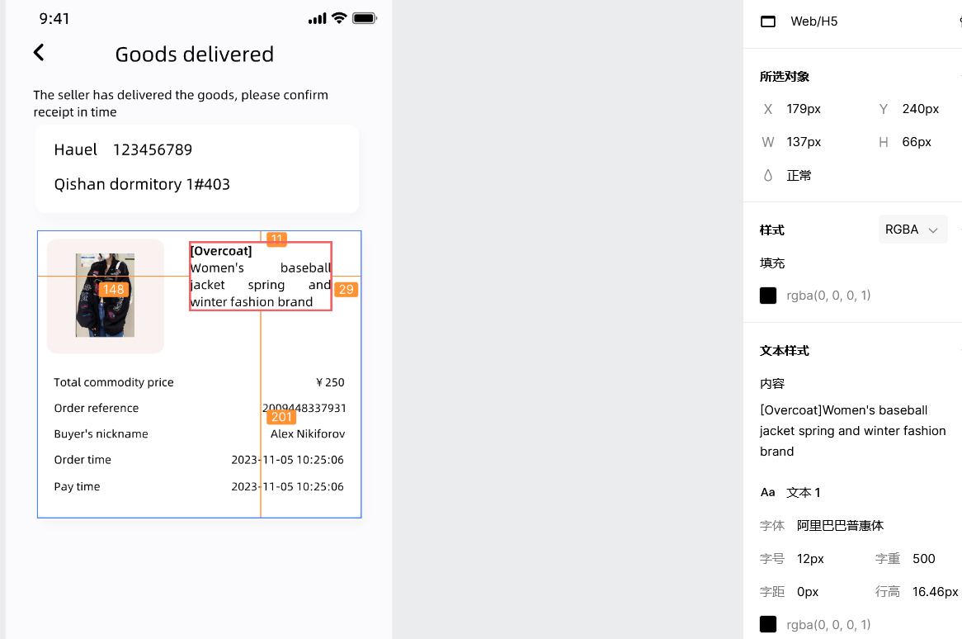
02
UI Design Concept
1.User experience:
Color and font: The choice of color and font can also greatly affect the user experience. The main color of the project is low light chocolate yellow (orange), with a relatively soft visual effect, to bring users a relaxed and pleasant visual atmosphere.
RGB(250,238,236)
RGB(234,187,164)
RGB(237,164,164)
Subject color RGB(246,121,82)
Mainfont:AliBaba Puhui

Slide 17
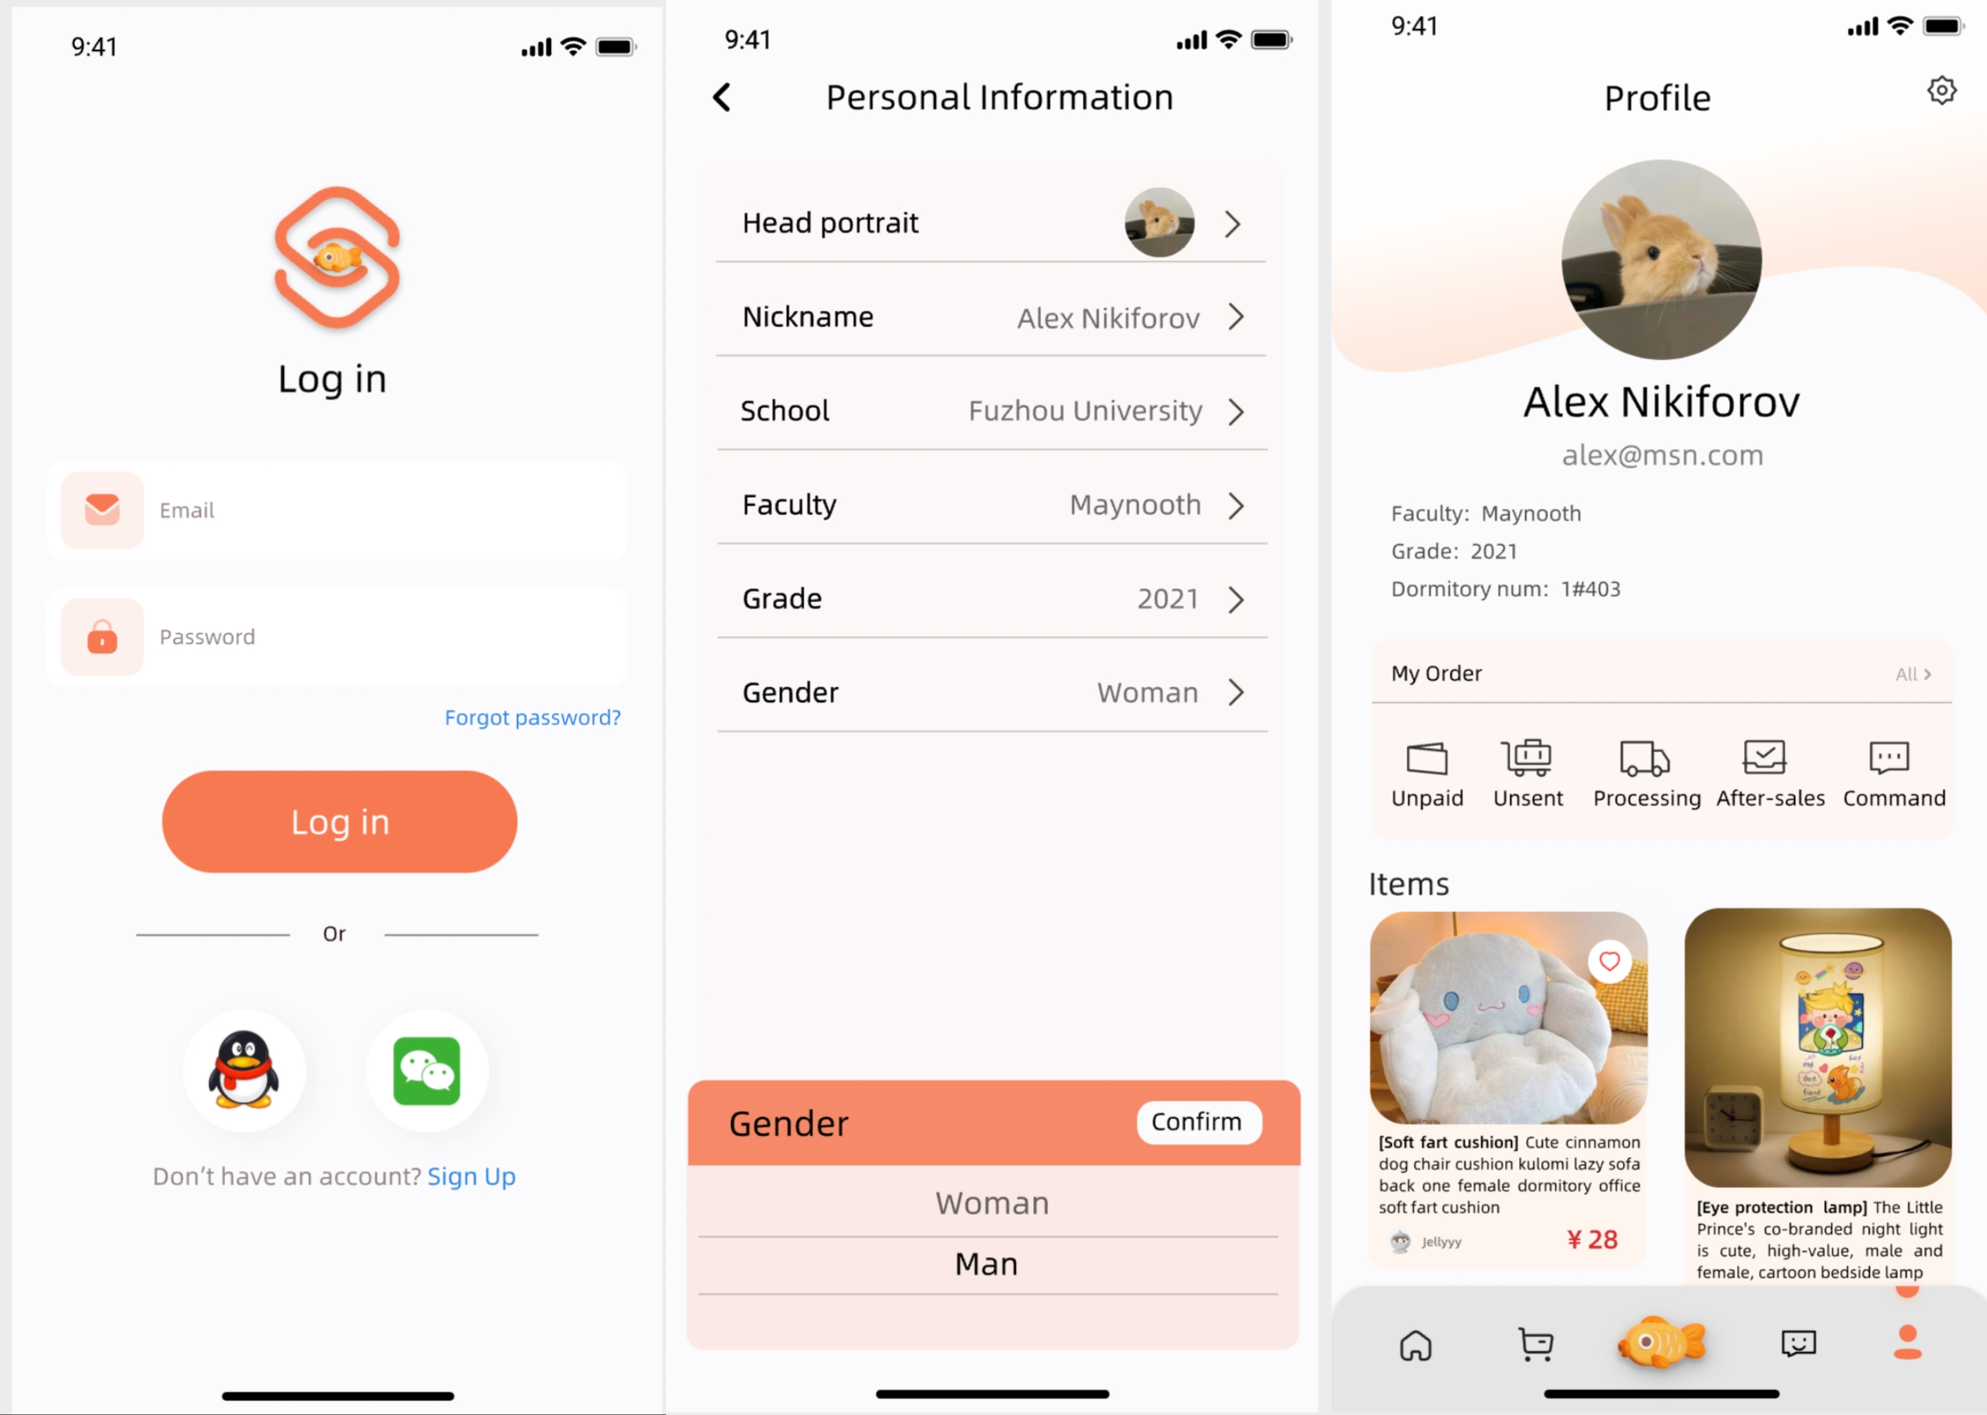
02
UI Design Concept
1.User experience:
Page flow and layout:UI design needs to ensure that the pageflow is simple and clear, and the layout is clear.

Slide 18
02
UI Design Concept
2. Brand image:
Logo and icon design: Logo and icon in UI design are the key to brand image;
Theme colors: Theme colors highlight the brand identity and core message, while creating a unique visual style and atmosphere.

Slide 19
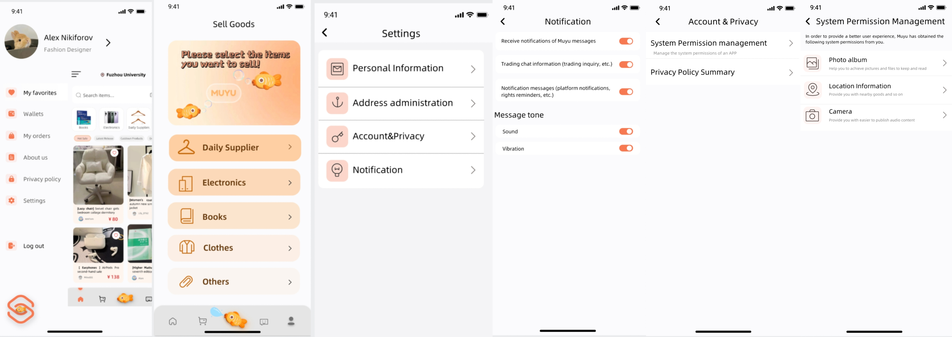
02
UI Design Concept
3. Information Architecture:
Navigation and classification:Proper navigationdesign and product classification allows users to quickly find the informationthey need, and provides access to other important functions through side bars or bottom navigation.

Slide 20
02
UI Design Concept
3. InformationArchitecture:
Search and filtering: Search functions and filtering functions are also important components of information architecture. Designing an easy-to-use search box and filter can greatly improve the efficiency of users to find products.

Slide 21
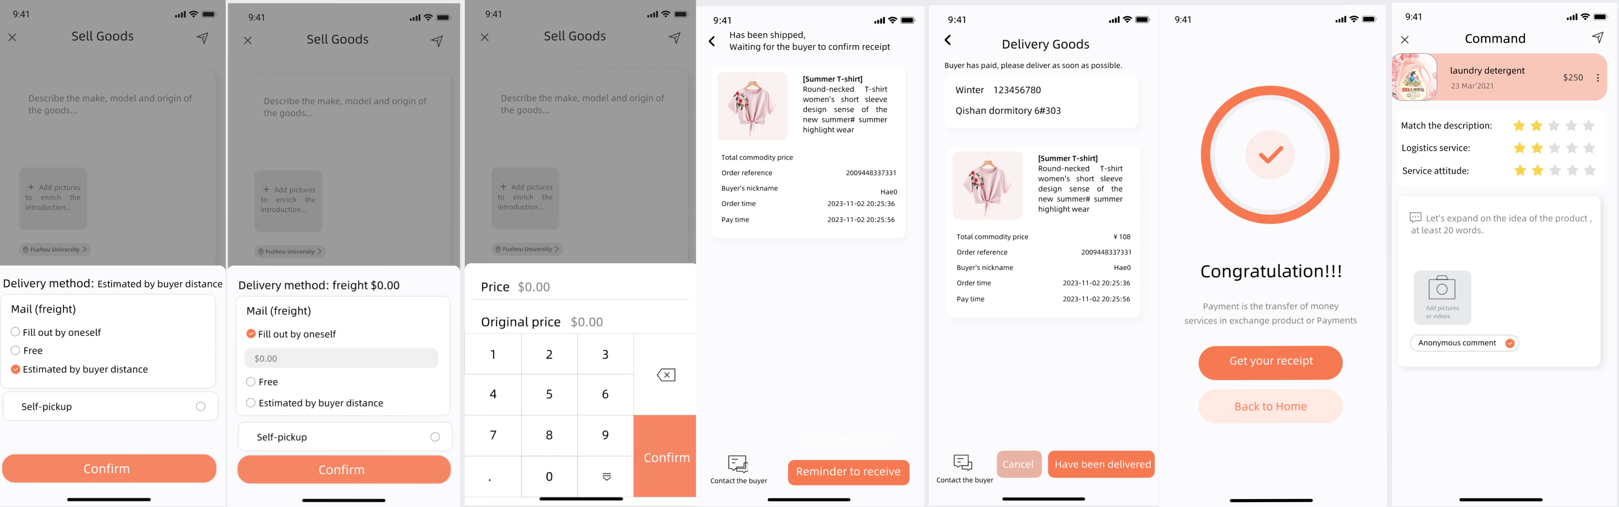
02
UI Design Concept
4. Interaction design：
Forms and inputs: When filling out forms or entering information, UI design needs to ensure that these actions are as simple as possible.

Slide 22
03
Research Experience

Slide 23
03
Research Experience
During the design process, our project staff encountered the following difficulties:
Lack of design inspiration: Beginners or inexperienced designers may feel overwhelmed when starting a new UI design, lacking in creativity and inspiration.
Software tool learning curve: It may take a while for beginners to become familiar with the interface, functionality, and operation of the tool.
Design decision confusion: When faced with multiple design options, designers could become confused and unsure of which design solution is best.

Slide 24
03
Research Experience
Here is our solution:
Look for design inspiration: Browsing design websites, referring to good portfolios, analyzing competing designs, etc., can provide inspiration for designers.
Learn and master the design tools: Through watching tutorials and practical operation, gradually familiar with and master the UI design tools.
Clear design goals: Before the design starts, clear design goals and constraints, which helps to reduce the confusion of design decisions.
Establish an effective team collaboration process: Set clear communication channels, such as regular design review meetings, online collaboration tools, etc., to improve the efficiency of team collaboration, and actively listen to and integrate the opinions and suggestions of other team members.

Slide 25
04
Improvement Plan

Slide 26
04
Improvement Plan
1. User feedback:
User feedback is the most important source to improve the design. Users' opinions and suggestions on the interface can be collected through user tests, surveys or interviews, etc. According to the feedback, the design can be adjusted to better meet the needs of users.
2. Detail optimization:
After the preliminary design is completed, UI designers will continue to optimize the interface color matching, interactive buttons, typesetting, text font and software logo design.

Slide 27
04
Improvement Plan
3. Interactive experience:
Designers will evaluate the interactive experience of the interface, checking whether the operation process is smooth and whether there are unnecessary steps or obstacles. Finally, they will optimize the interaction process and improve the efficiency of users to complete tasks.2. Detail optimization:
4. Responsiveness and adaptability:
Designers will examine how the design performs across devices, screen sizes and resolutions. At the same time, the image loading and code quality will be checked to ensure that the interface loads quickly and the interaction is smooth

Slide 28

E
N
D
THANKS

